Slide 1
Introduction to quantum computing (1)
Umar Alhuwaymel

Slide 2
Outline
History of Computers
Motivation
Quantum Mechanics
Theory
Superposition
Harmonic Oscillators
Computer Science
Qubit Representation
Classical Gates
Quantum Gates
Hardware
Physical Realisations
Superconducting Qubits
History of Fabrication

Slide 3
History of Computers

Slide 4
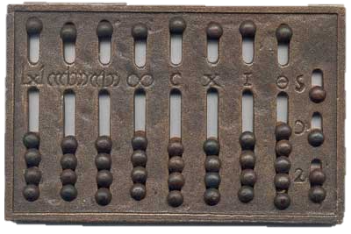
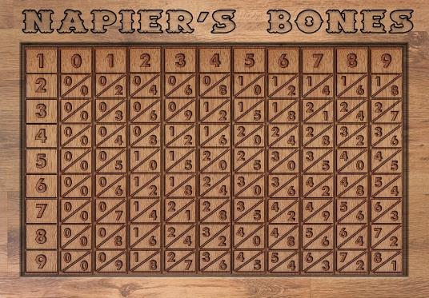
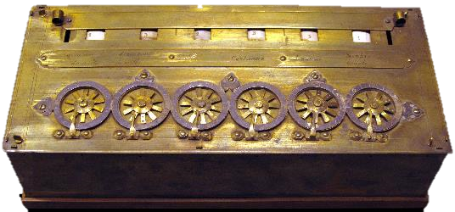
History of Computers
Abacus - 2400 BC
Babylonia
Napier’sBones - 1617
Scotland
Pascal’s Calculator - 1642
France

Slide 5
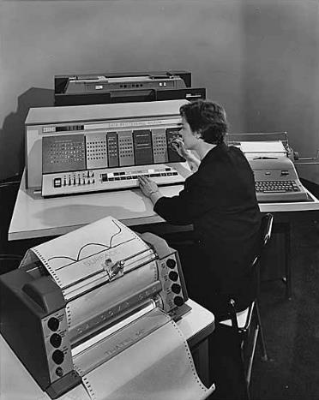
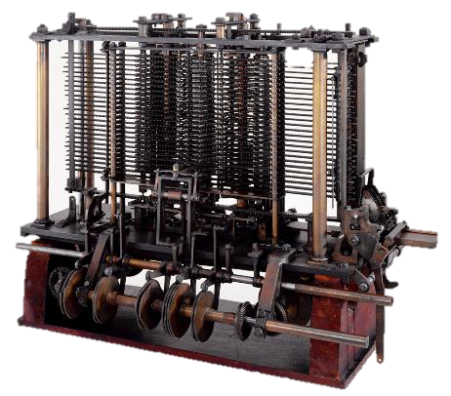
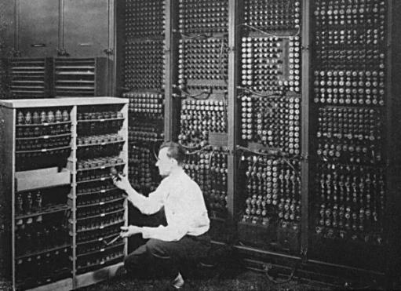
History of Computers
Analytical Engine - 1833
Charles Babbage, England
Vacuum Tubes¹ - 1951
Transistor Computers² - 1956

Slide 6
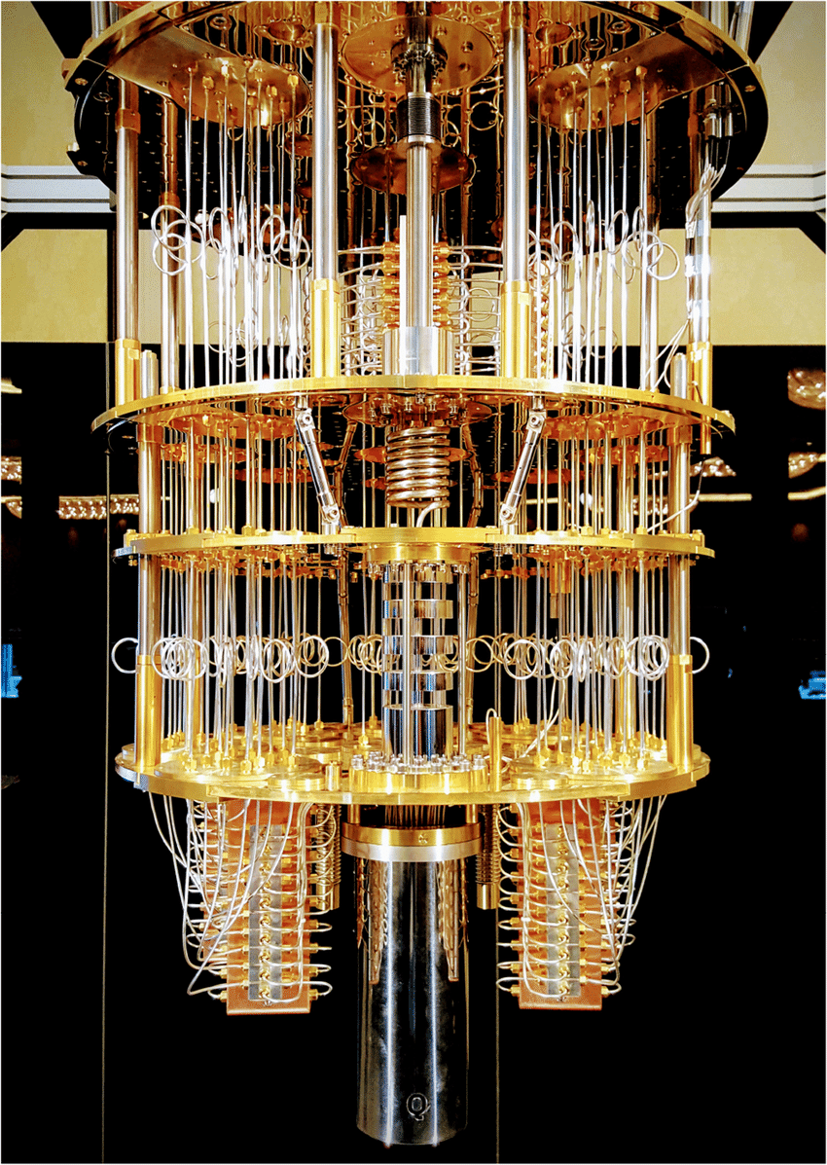
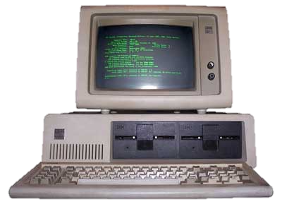

History of Computers
IC Computer³ - 1964
Microprocessor Computers⁴ - 1971
Quantum Computers⁵ - Present

Slide 7
Motivation

Slide 8
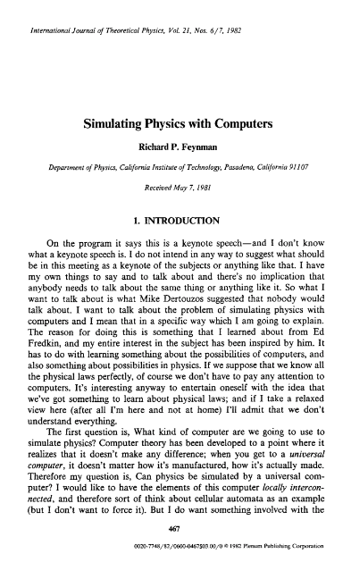
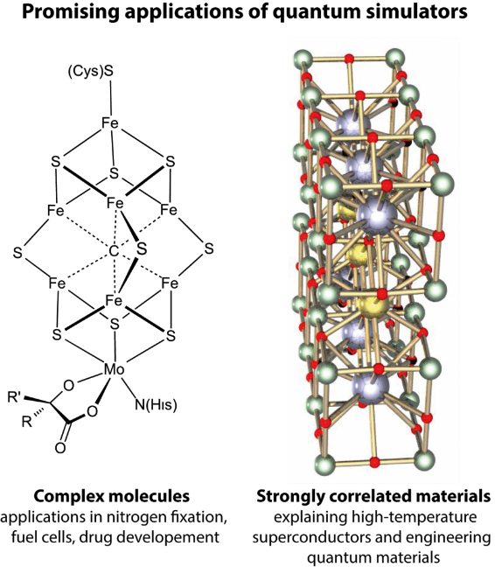
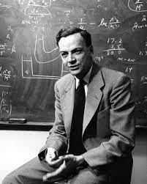
Motivation
“Nature isn't classical, dammit, and if you want to make a simulation of nature, you'd better make it quantum mechanical, and by golly it's a wonderful problem, because it doesn't look so easy.”
Richard Feynman

Slide 9
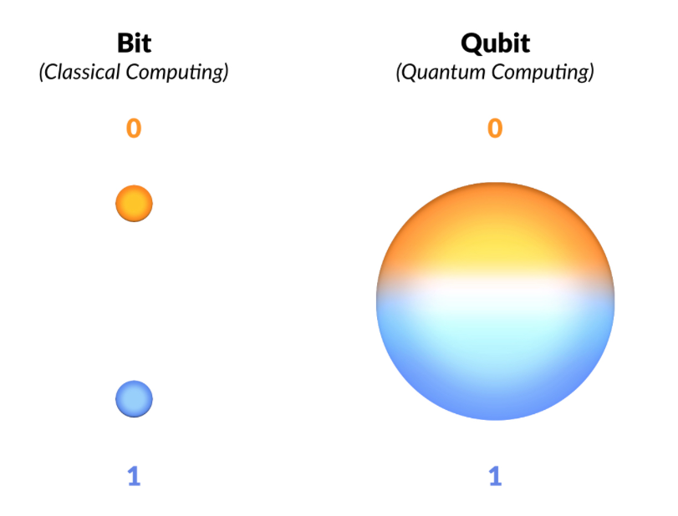
Motivation
Number of Qubits | Possible Readings
1 | 0
 | 1
2 | 0 0
 | 0 1
 | 1 0
 | 1 1
3 | 0 0 0
 | 0 0 1
 | 0 1 0
 | 0 1 1
 | 1 0 0
 | 1 0 1
 | 1 1 0
 | 1 1 1
n → 2^{n}

Slide 10
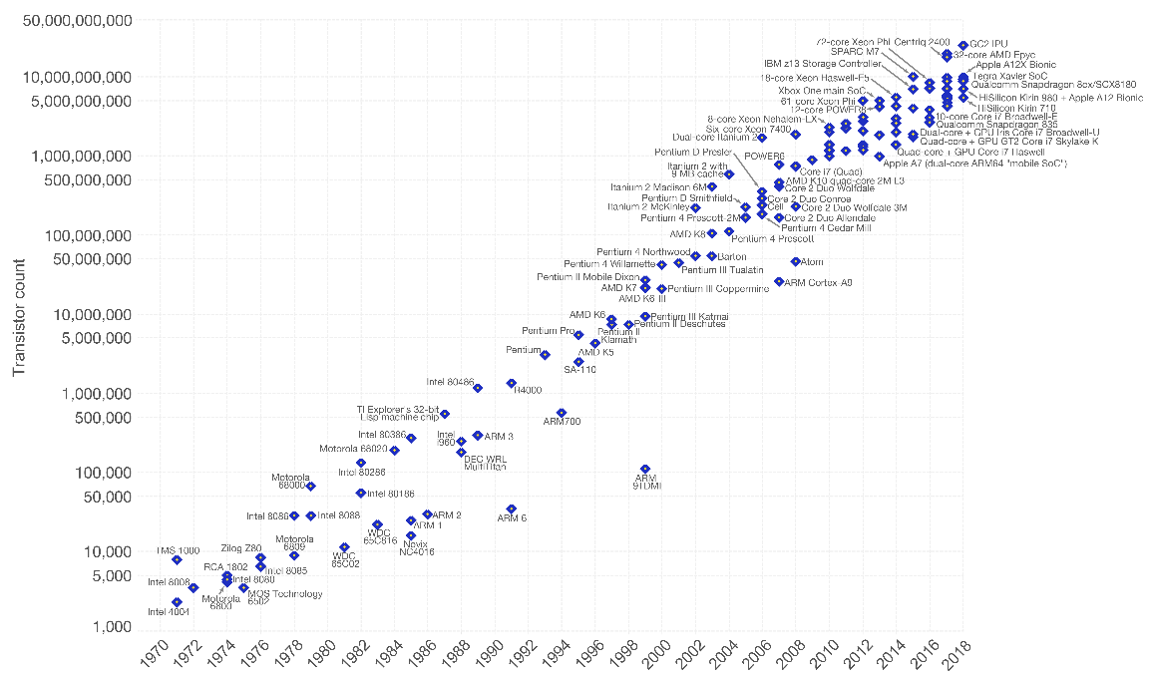
Motivation
Moore’s Law

Slide 11
Quantum mechanics

Slide 12
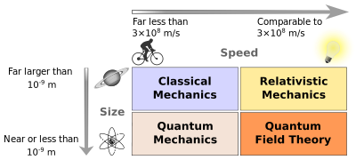
Quantum Mechanics

Slide 13
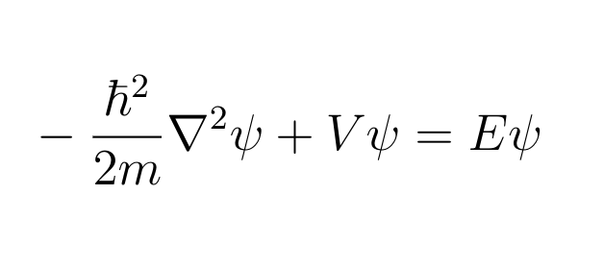
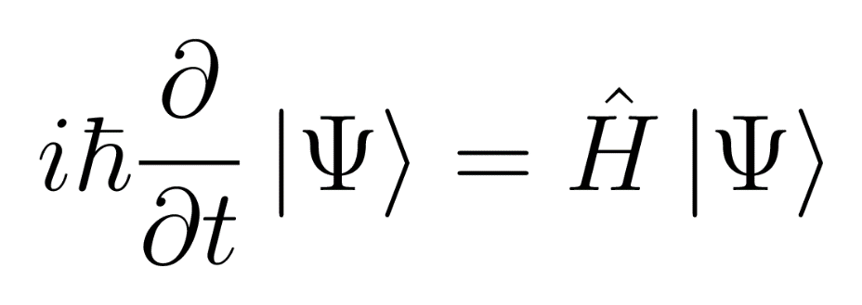
The Schrödinger Equation
Solution = |Ψ> = wavefunction

Slide 14
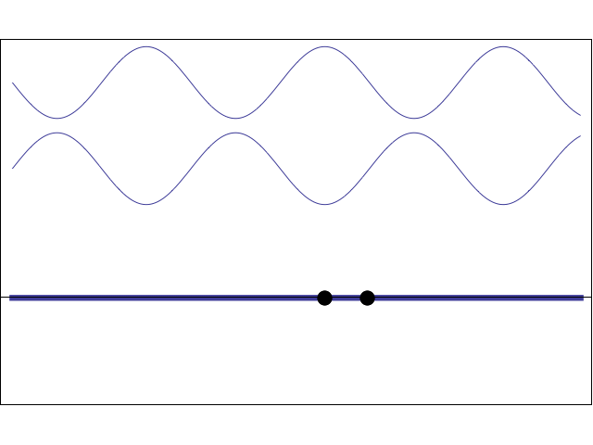
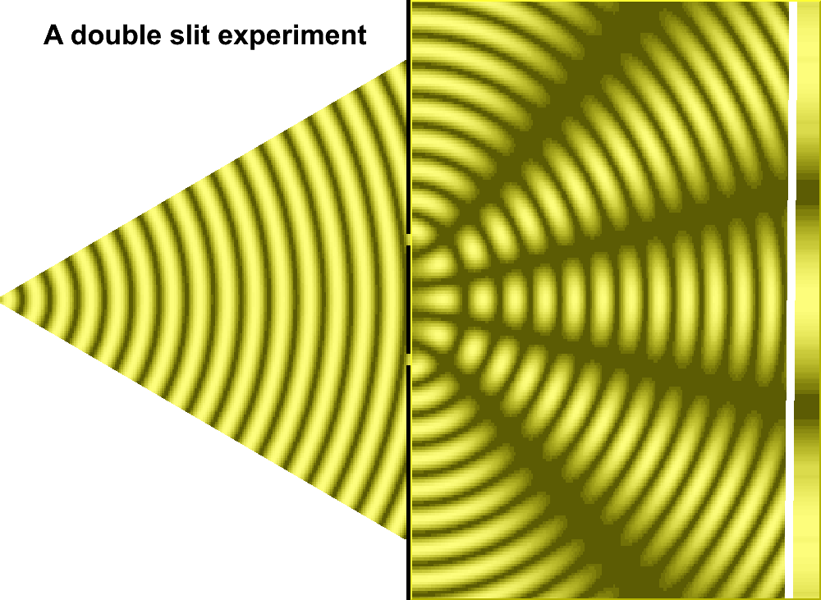
Superposition

Slide 15
Superposition
|Ψ_{total}> = a|Ψ₁> + b|Ψ₂> + c|Ψ₃> + …
|Ψ_{total}> is a 'SUPERPOSITION' of states Ψ₁, Ψ₂, and Ψ_{3.}

Slide 16
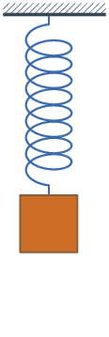
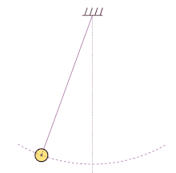
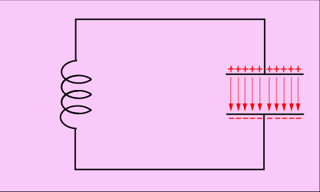



Harmonic Oscillators
$$T=2π\sqrt{\frac{L}{g}}$$
$$T=2π\sqrt{LC}$$
$$T=2π\sqrt{\frac{L}{1/C}}$$
$$T=2π\sqrt{\frac{m}{k}}$$

Slide 17
Computer Science

Slide 18
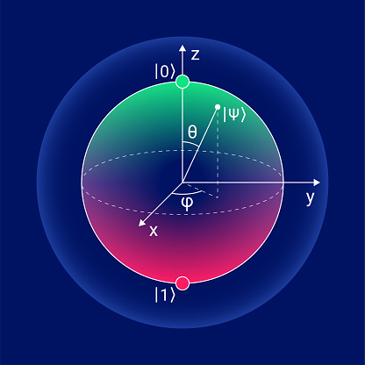
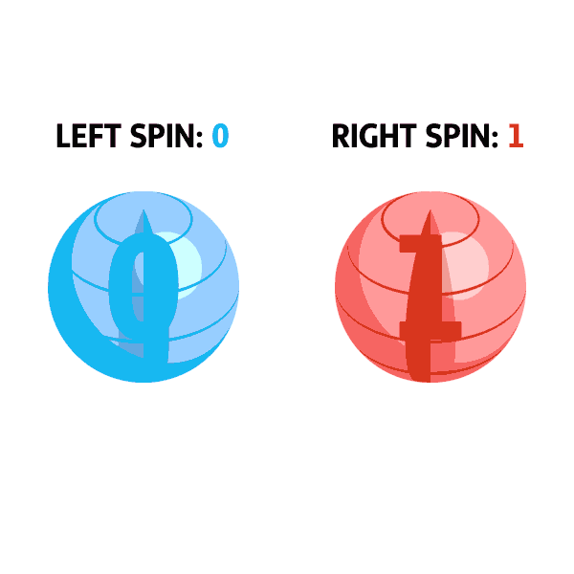
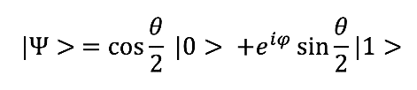
Qubit Representation
Illustration of superposition

Slide 19
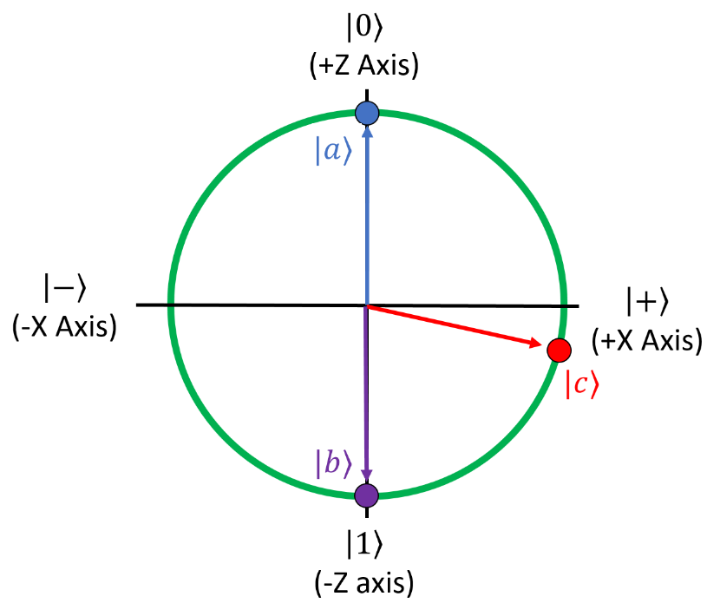
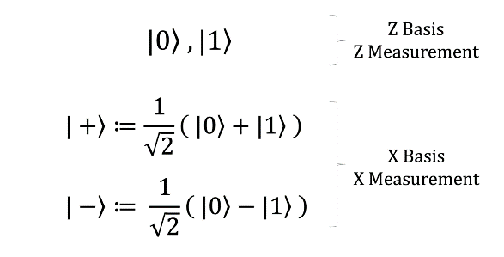
Qubit Representation
Gate | Measurement
X | +
 | -
Z | 0
 | 1
|Ψ_{qubit}> = a|0> + b|1>
2D representation of qubit

Slide 20
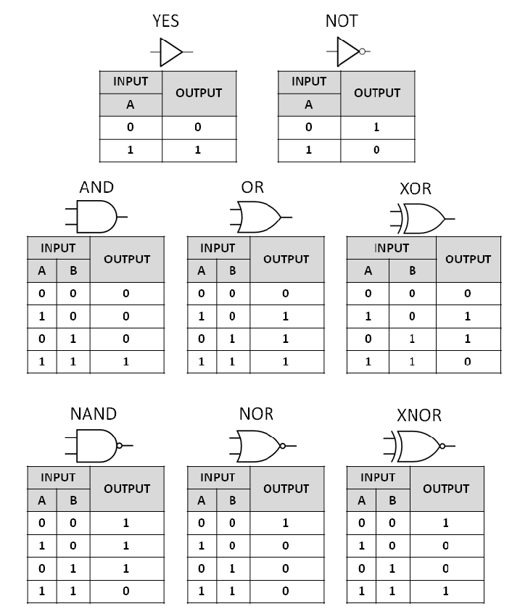
Classical gates

Slide 21
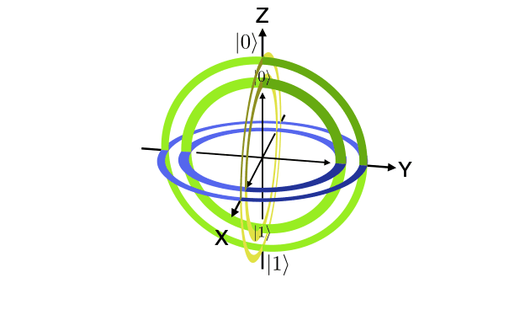
Quantum Gates

Slide 22
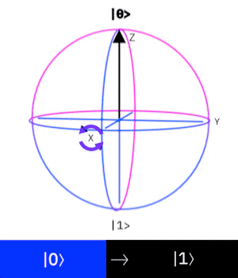
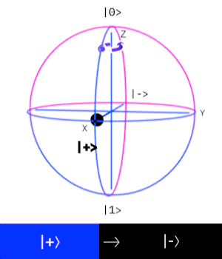
Quantum gates
X
Z

Slide 23
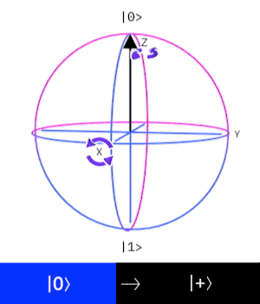


Quantum Gates
H
0
H
$$\frac{\left.\left|0\right.\right\rangle }{\sqrt{2}}+\frac{\left.\left|1\right.\right\rangle }{\sqrt{2}}$$
1

Slide 24
Hardware

Slide 25
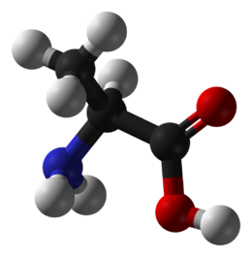
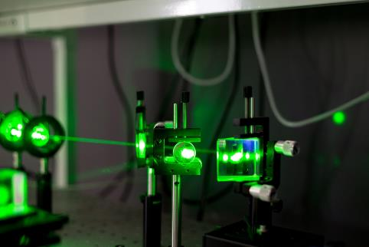
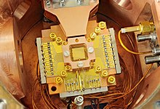
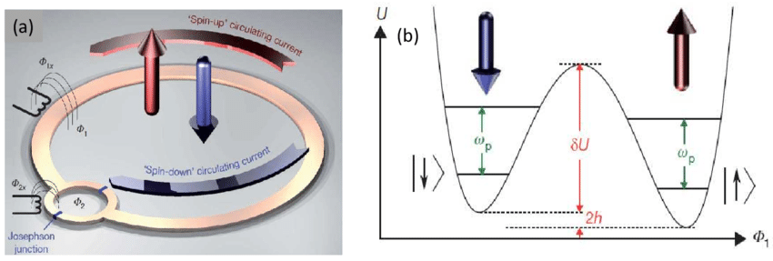
Physical Realisations
NMR
Photonics
Ion traps
Superconducting qubits

Slide 26
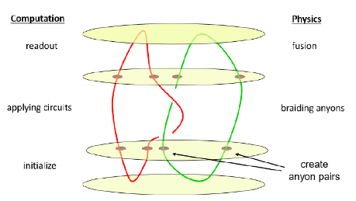
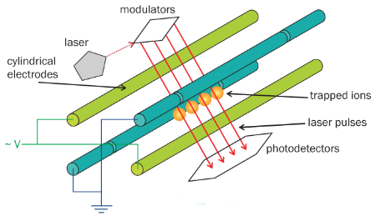
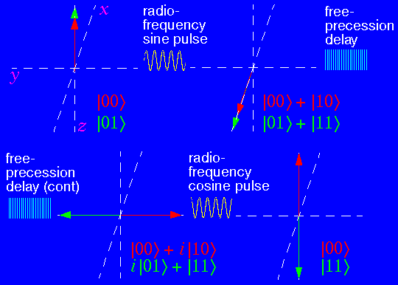
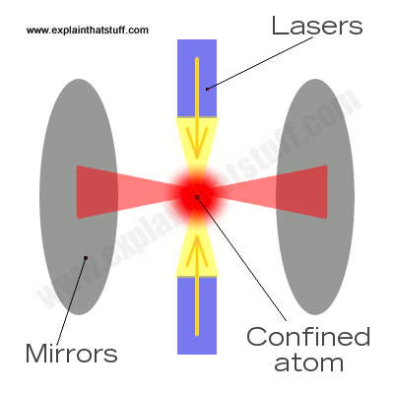
Possible physical qubits
Topological Qubit
Ion Trap Qubit
NMR Qubit
Optical Cavity
Qubit = Majorana Fermions
Qubit = Electronic State of Ions
Qubit = Nuclear spin
Qubit = Spin of confined atoms

Slide 27
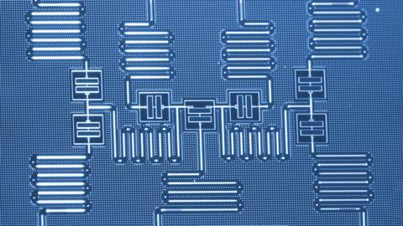
Superconducting qubits
Qubit = Superconducting Electrical Circuits

Slide 28
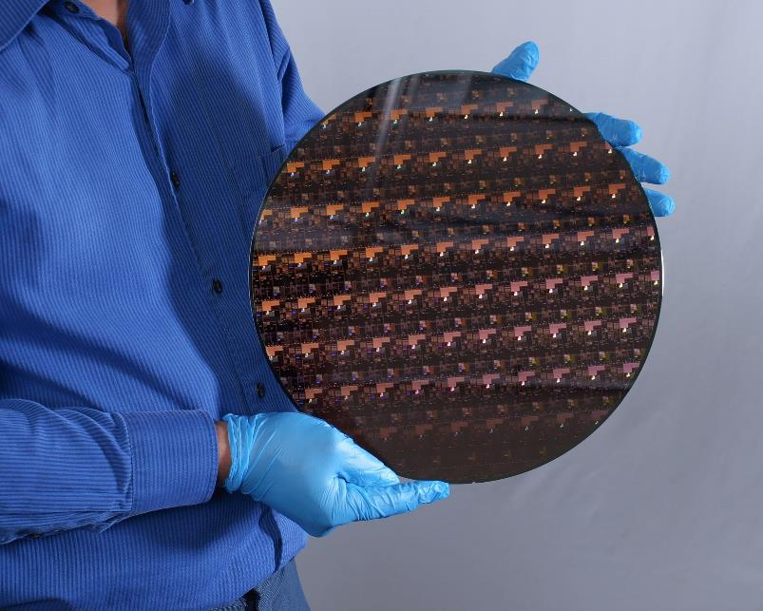
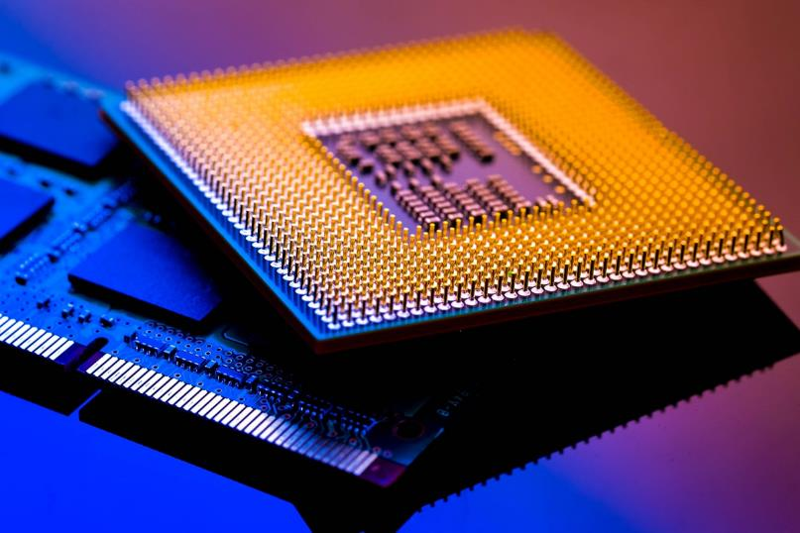
History of fabrication

Slide 29
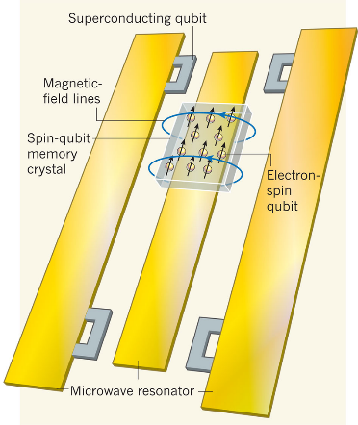
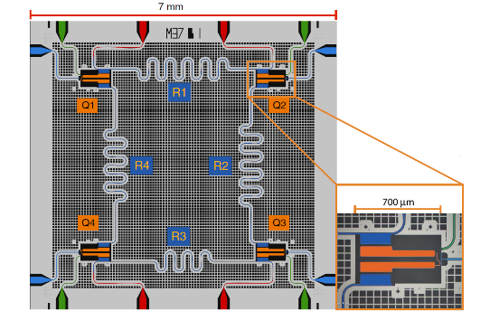
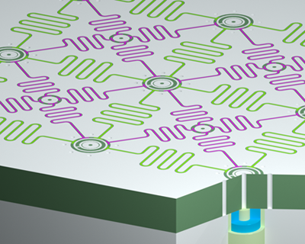
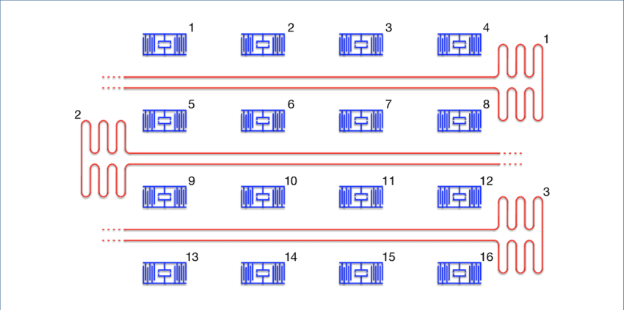
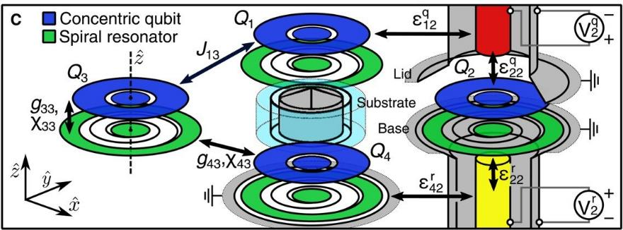
Superconducting qubit architecture

Slide 30
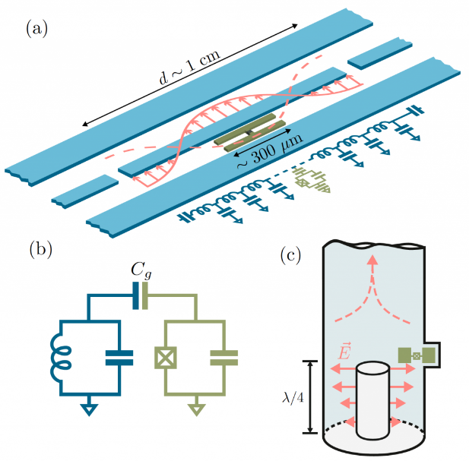
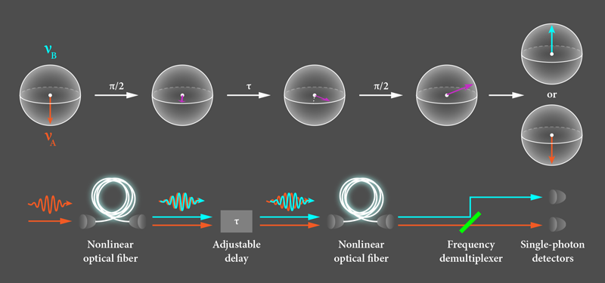
cQED and cQED

Slide 31
Advantages of superconducting qubits
(Much) Faster gate times
Easy to fabricate and manipulate
Very mature technology
(Qubit lifetime vs. Gate operation time)

Slide 32
Thank you for listening
See you tomorrow

Slide 33
Introduction to quantum computing (2)
Umar Alhuwaymel

Slide 34
Outline
Superconducting Qubits
Harmonic oscillators as a paradigm
LC circuits & resonators
Superconductivity
Josephson Junctions
Design & simulation of resonators
Quantum Algorithms
Deutsch-Jozsa’s Algorithm (1992)
Shor’s Algorithm (1994)
Grover’s Algorithm (1996)

Slide 35
Superconducting Qubits

Slide 36
cQED and cQED

Slide 37
Harmonic Oscillators
$$T=2π\sqrt{\frac{L}{g}}$$
$$T=2π\sqrt{LC}$$
$$T=2π\sqrt{\frac{L}{1/C}}$$
$$T=2π\sqrt{\frac{m}{k}}$$

Slide 38
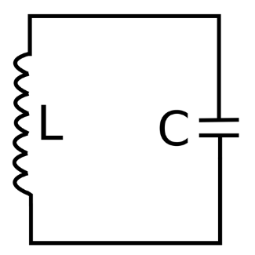
LC Circuits
Inductor (L)
Capacitor (C)
Passive electrical device
Stores energy
Energy in MAGNETIC fields
Passive electrical device
Stores energy
Energy in ELECTRIC fields

Slide 39

Resonators
Electric and Magnetic fields
Frequency
Charging & discharging
Increase in voltage, current, sound, etc.

Slide 40


Superconducting Electrical Circuits
Electrical circuits = LC Circuits
What does it mean to be ‘Superconducting’?

Slide 41


Superconductivity
What is conduction?
Superconductor → zero resistance
Magnetic field lines non-existent
Unique critical temperature for each material

Slide 42


Superconductivity explained
Crystal lattice of metals
Cooper pairs (1956)
BCS Theory (1972 Nobel Prize)
John Bardeen
Leon Cooper
Robert Schrieffer

Slide 43




Josephson Junctions
Brian David Joesphson (1962)
$I=I_{C}\sin{∅}$
$V=\frac{d∅}{dt}$
S-I-S, S-N-S, S-C-S
NL inductors
LC + NLC = qubit

Slide 44


The physical superconducting qubit

Slide 45

Design & simulation of resonators
ANSYS HFSS, COMSOL, …
Dimensions
Results

Slide 46

S-parameters
Electromagnetic field behaviour inside the material
Resonance frequencies

Slide 47

S-parameters

Slide 48

S-parameters

Slide 49

Fabrication process

Slide 50
What next?
Theory
History of Computer
Quantum Mechanics
Hardware
Superconducting Circuits
Design & simulation
Quantum Algorithms

Slide 51
What next?
Qiskit (IBM)
Introductory course: https://learn.qiskit.org/course/introduction/why-quantum-computing
Textbook: https://qiskit.org/textbook/preface.html
Projects +
Theory → application
Quantum Computation and Quantum Information by Isaac Chuang and Michael Nielsen
Examples

Slide 52
Quantum Algorithms

Slide 53

Overview
Quantum gates
Quantum circuits
Theory → implementation
Fully developed algorithms

Slide 54





Quantum gates
States initialized to |0>
Classical bits for measurement
X-gate:
X|0> = |1>
X|1> = |0>
Controlled gates are activated if input is |1>

Slide 55
Real Algorithms
In the 1990’s
HUGE push for quantum computing
Bridge between theory and experiment

Slide 56

Deutsch-Jozsa’s Algorithm (1992)
David Deutsch + Richard Jozsa (Oxford)
Determinnistic
f: {0, 1} → {0, 1}
Check if f(0) = f(1)

Slide 57

Classically
Number of bits | Possible outcomes | Number of queries needed
2 | 00, 01, 10, 11 | 2
3 | 000, 001, 010, 011, 100, 101, 110, 111 | 3
4 | 0000, 0001, 0010, 0011, 0100, 0101, 0110, 0111, 1000, 1001, 1010, 1011, 1100, 1101, 1110, 1111 | 4

Slide 58


Quantum Algorithm

Slide 59
Classical vs quantum “queries”
Number of bits | Number of queries needed
1 | 1
2 | 2
3 | 3
4 | 4
5 | 5
6 | 6
7 | 7
8 | 8
9 | 9
10 | 10
11 | 11
n | n
Number of qubits | Number of queries needed
1 | 1
2 | 1
3 | 1
4 | 1
5 | 1
6 | 1
7 | 1
8 | 1
9 | 1
10 | 1
11 | 1
n | 1

Slide 60
Summary
Deutsch-Jozsa Algorithm uses the oracle to check if the function is balanced or constant. O (N) → 1

Slide 61
Shor’s Algorithm (1994)
Peter Shor (MIT)
Prime integer factorisation
Speed

Slide 62
Procedure
Pick a random number, N (and make sure it is prime)
Greatest common divisor
f(x) a^{x} (mod N)
Quantum Fourier transform to find ‘r’, the period of the function

Slide 63


Fourier transform

Slide 64

Quantum Algorithm

Slide 65

Shor’s algorithm vs classical counterpart

Slide 66

Summary
Deutsch-Jozsa algorithm uses the oracle to check if the function is balanced or constant. O (N) → 1
Shor’s algorithm factorises integers to their prime factors. It manipulates the idea of QFT to speed the process up. O ($e^{N^{1/3}}$) → O (N³)

Slide 67
Grover’s Algorithm (1996)
Lov Grover (Cornell)
Database-searching algorithm
Structured vs. unstructured data

Slide 68
Structured data
Database
1
2
3
..
..
60
61
..
..
214
215
..
..
N
Ordered
Continuously halving databse
Size N → O(N/2)

Slide 69

Unstructured data
Classically O(N)
Quantum increases probability of correct choicce:

Slide 70

Grover’s Algorithm circuit

Slide 71

Illustration of Grover’s Algorithm

Slide 72

Summary
Deutsch-Jozsa algorithm uses the oracle to check if the function is balanced or constant. O (N) → 1
Shor’s algorithm factorises integers to their prime factors. It manipulates the idea of QFT to speed the process up. O ($e^{N^{1/3}}$) → O (N³)
Grover’s algorithm searches databses and incrementally increases the probability of a correct choice. O (N) → O ($\sqrt{N}$)

Slide 73

Conclusion
Theory, hardware, and software
Application
VQE, AOQA, and IBM Challenge
https://research.ibm.com/blog/ibm-quantum-open-science-prize-2022
Deadlin: April 15, 2023

Slide 74
Thank you for listening
ANY Questions?

